Slide 1
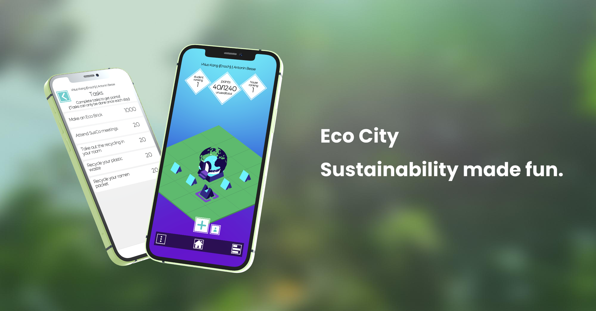

Slide 2
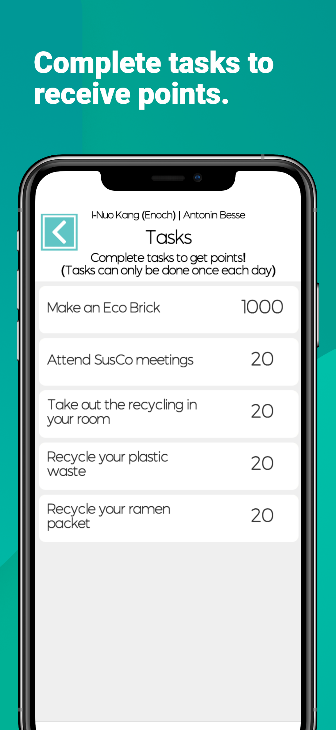
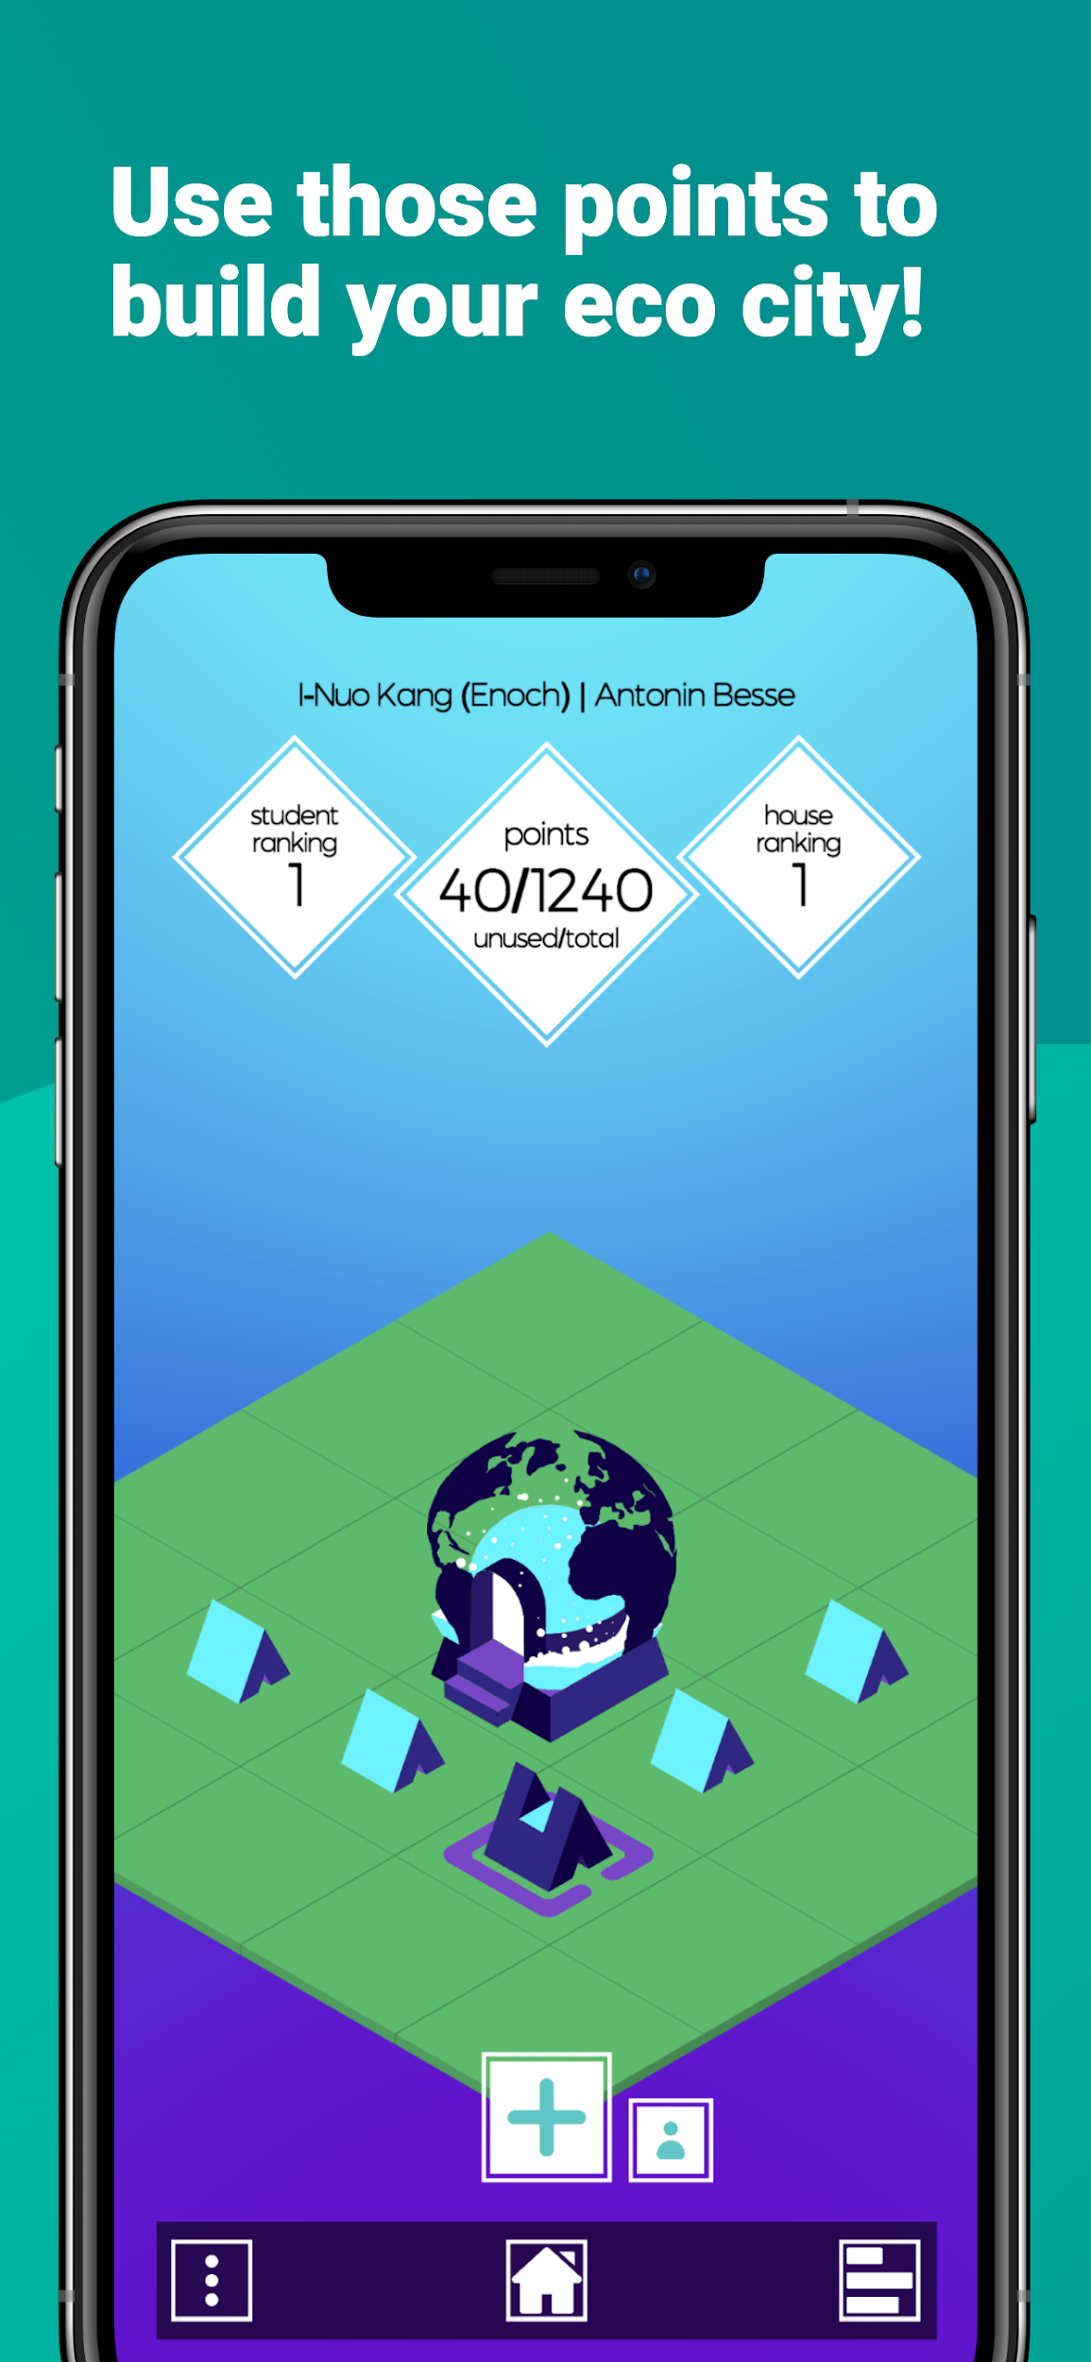
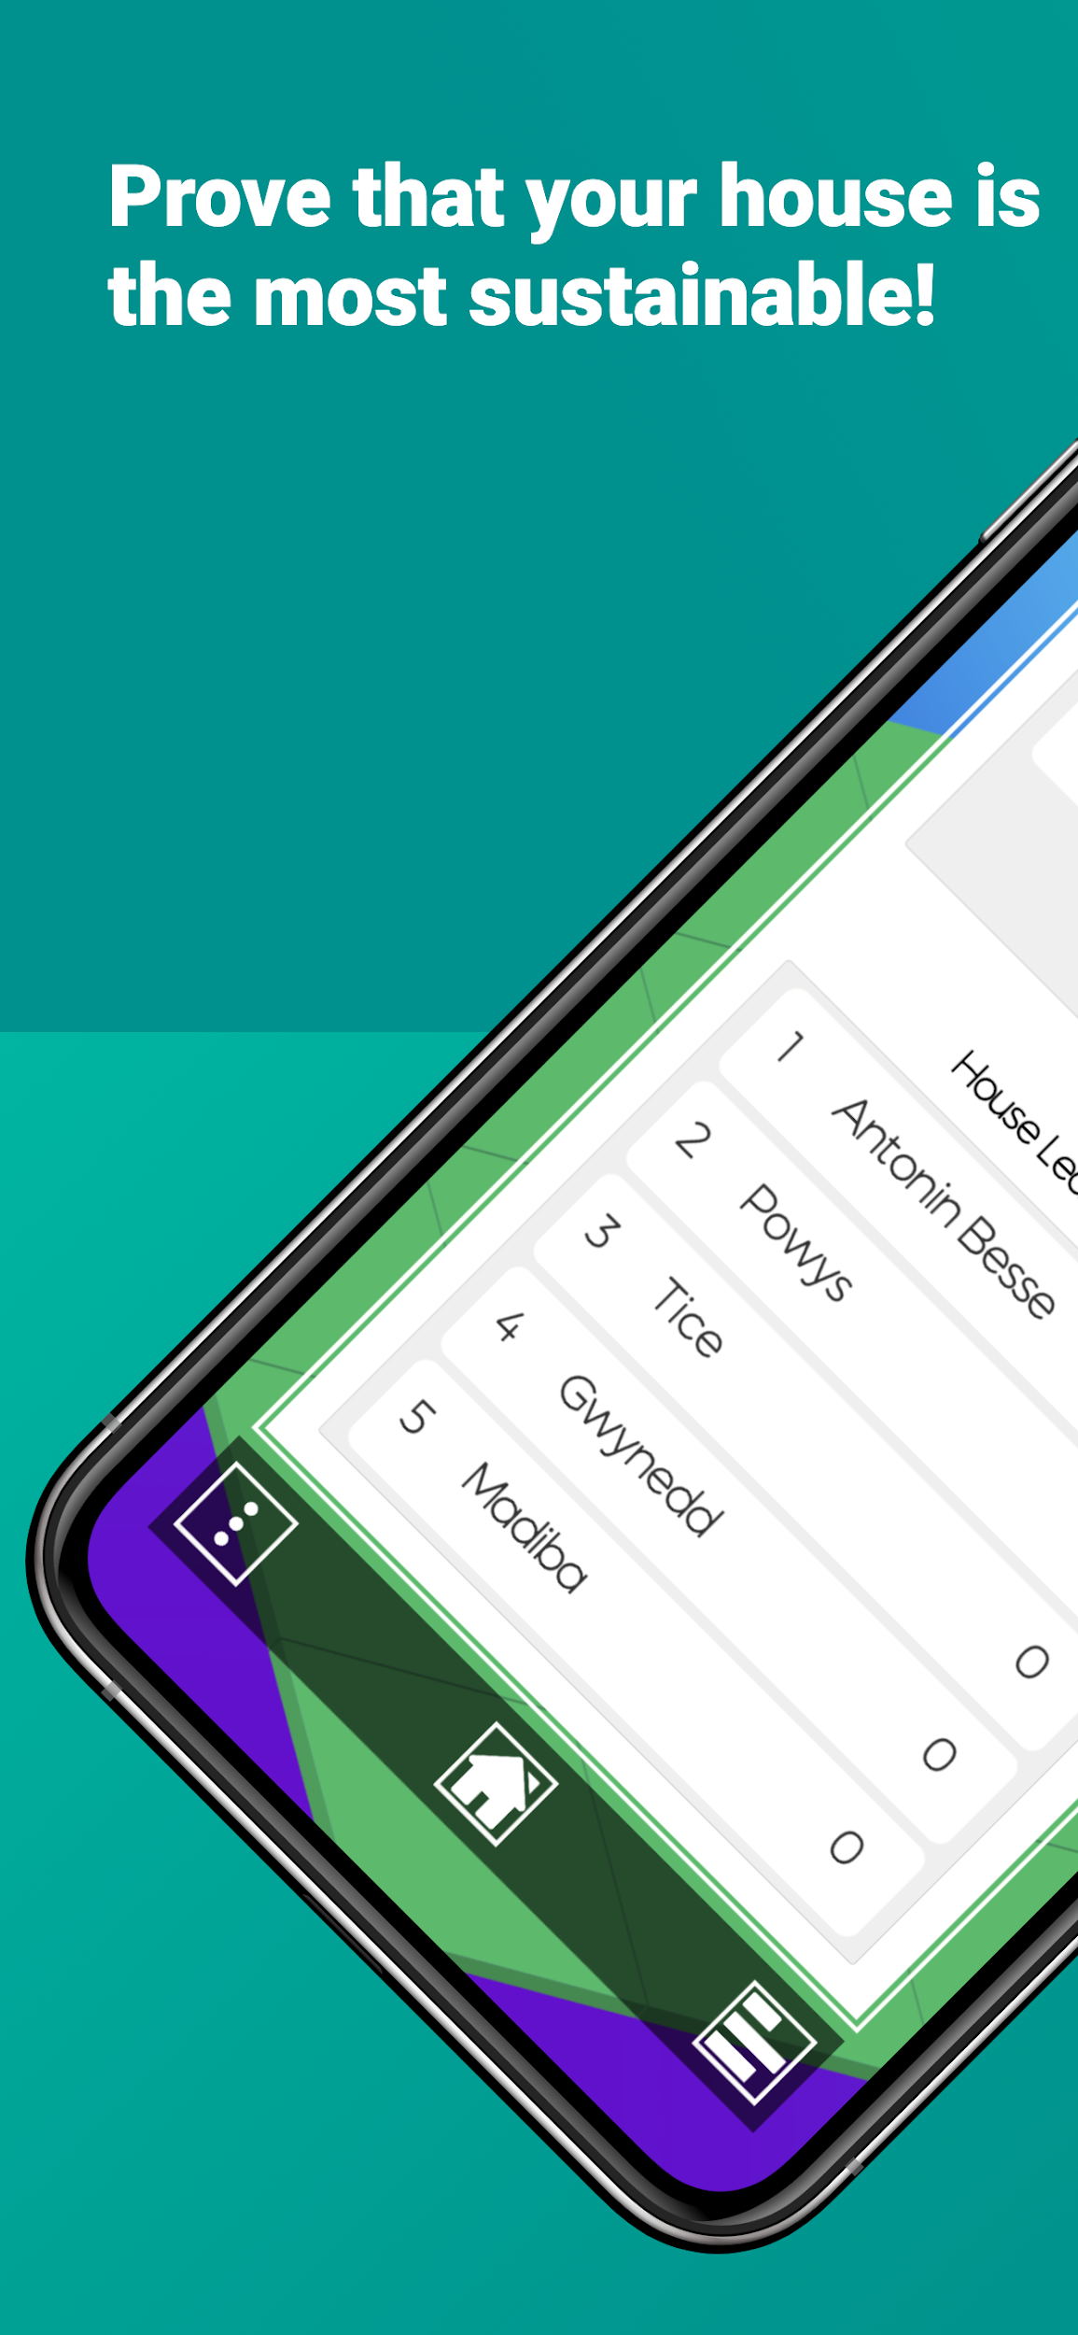
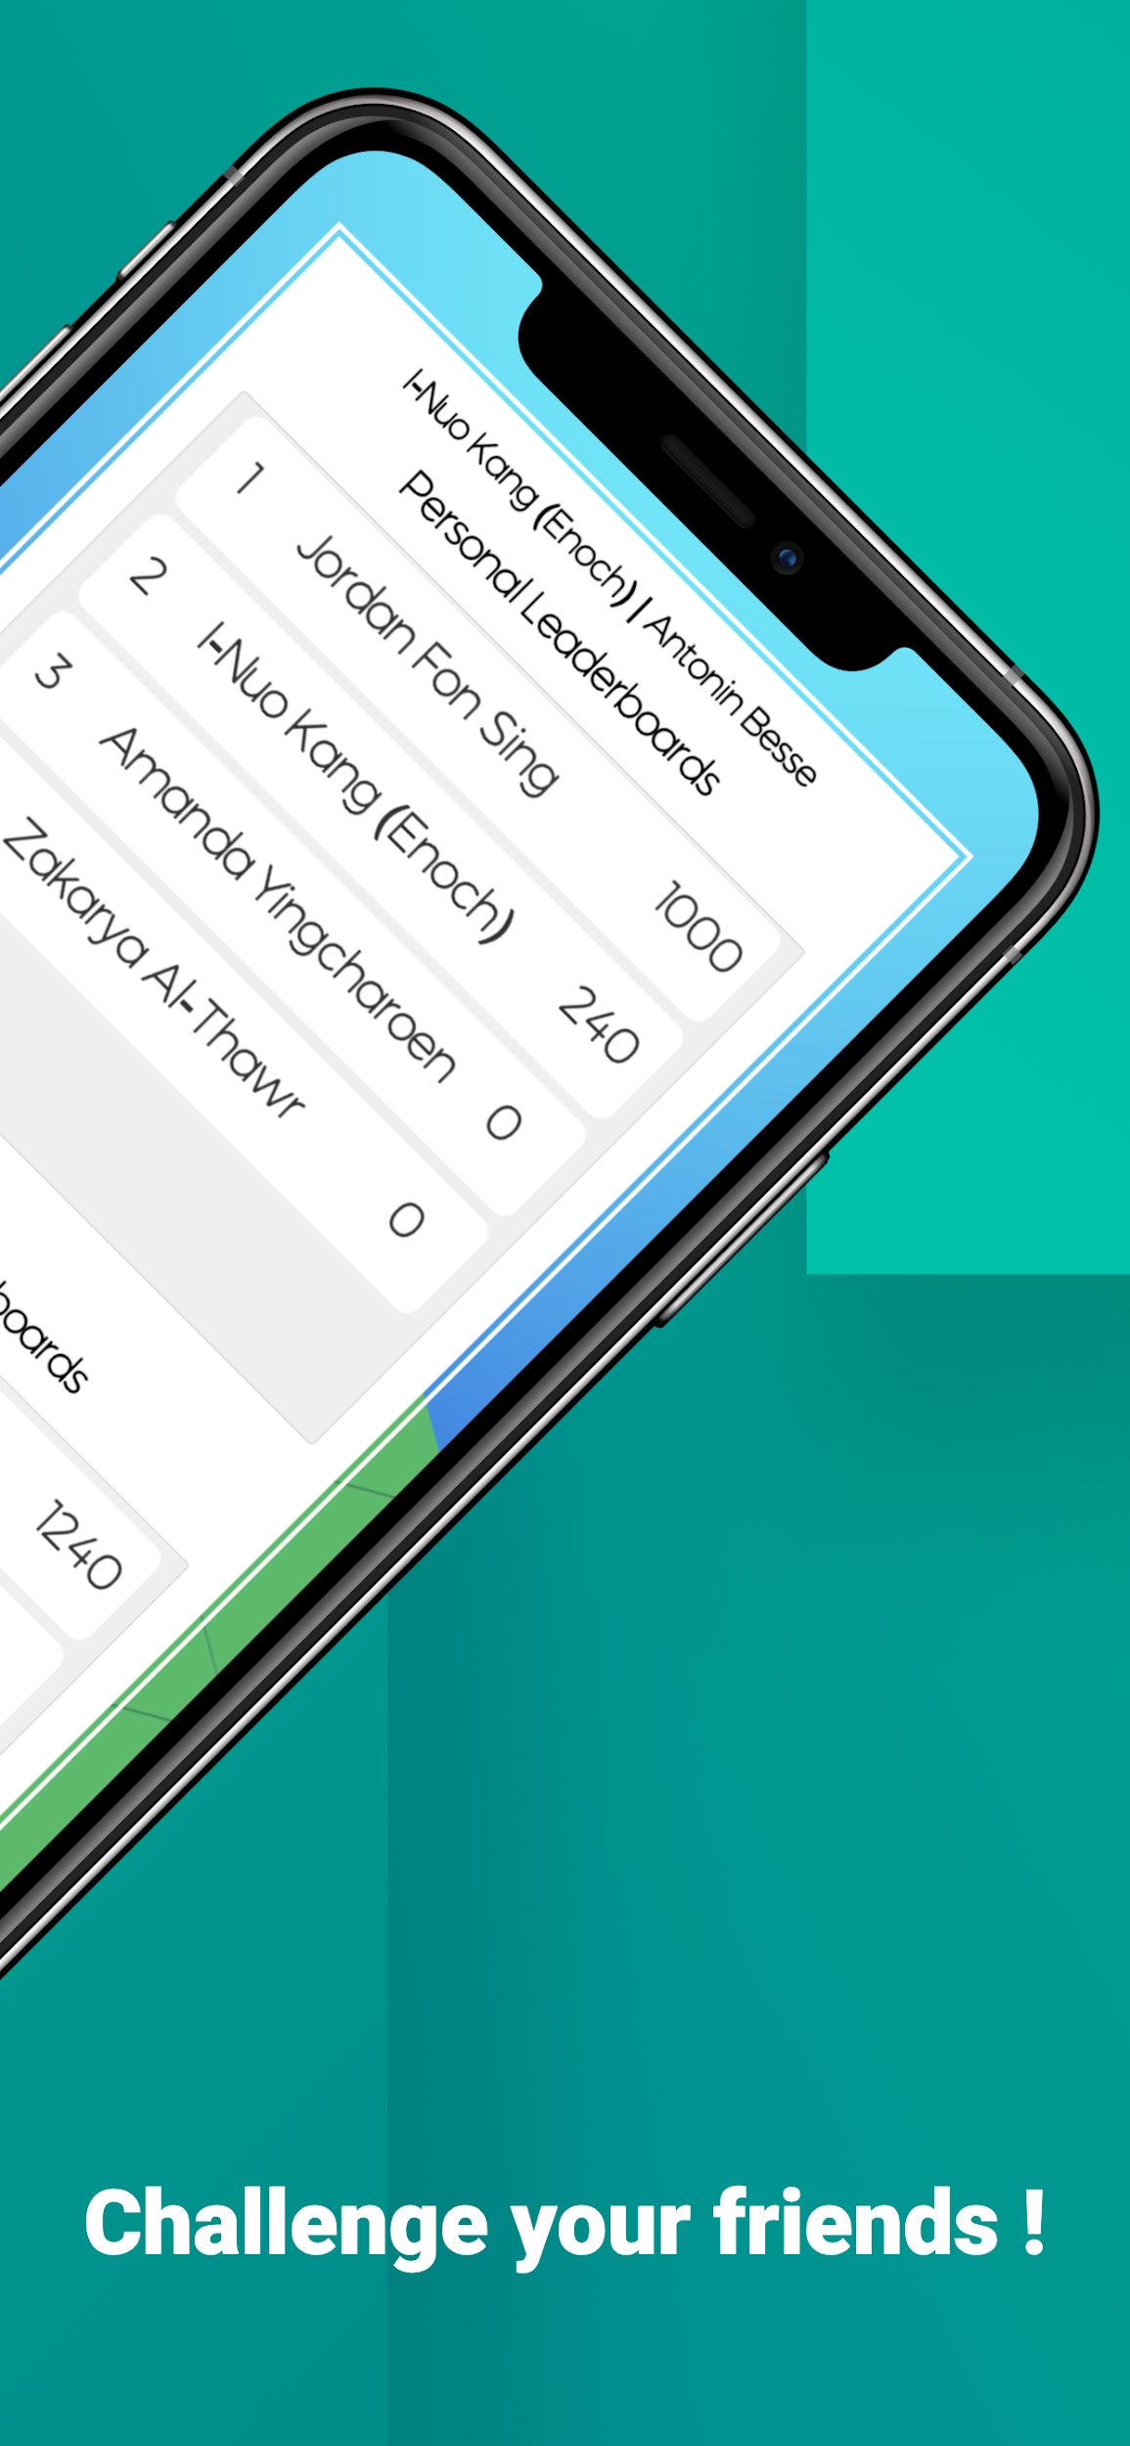
Overview
Notes:
Overview of the app’s main features

Slide 3
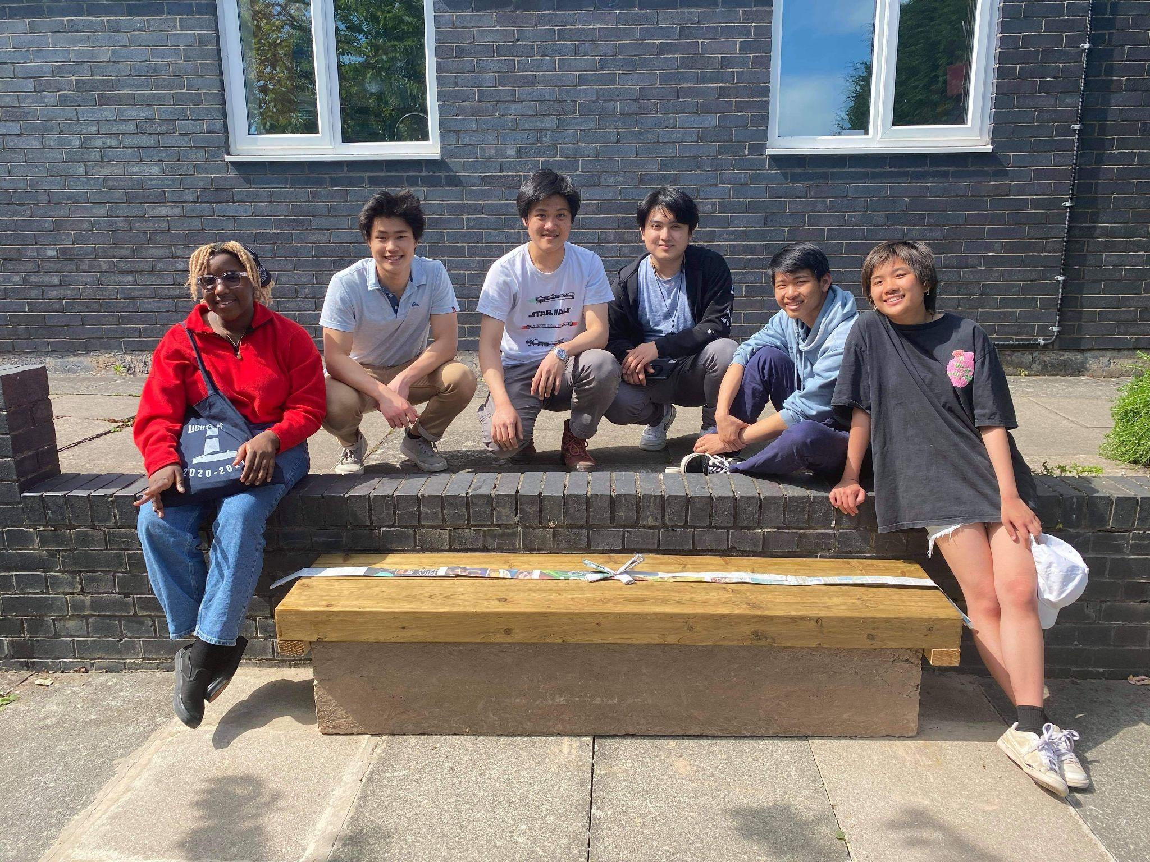
What are Eco Bricks?

Slide 4
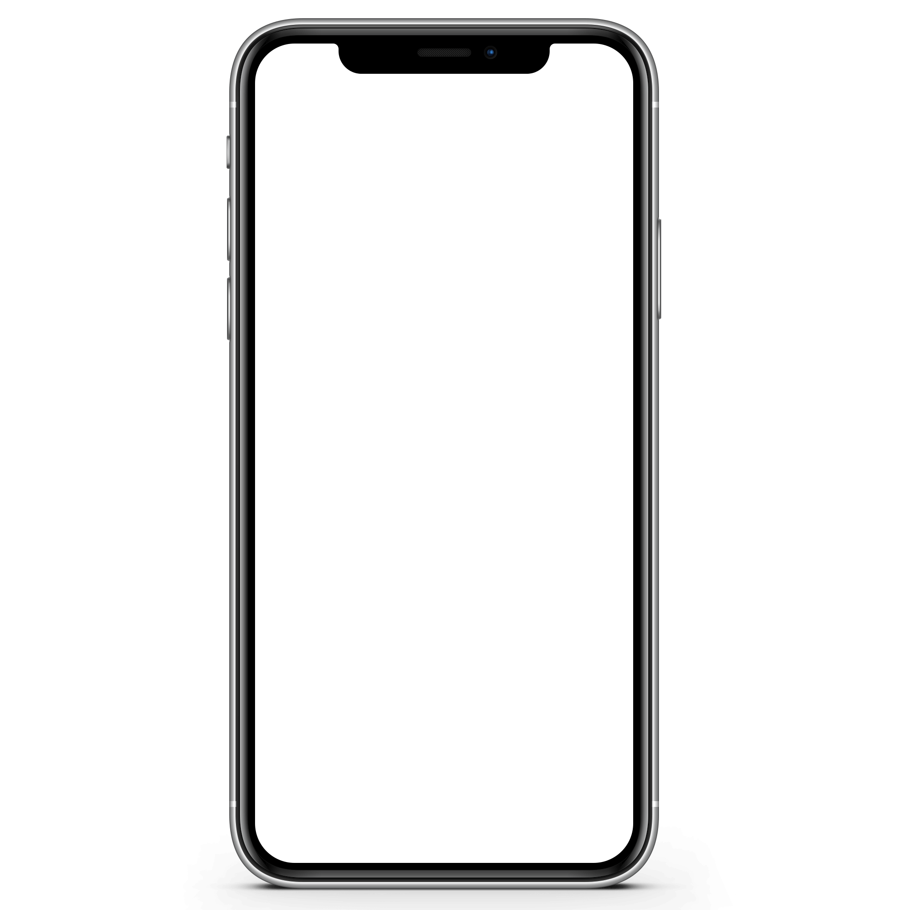
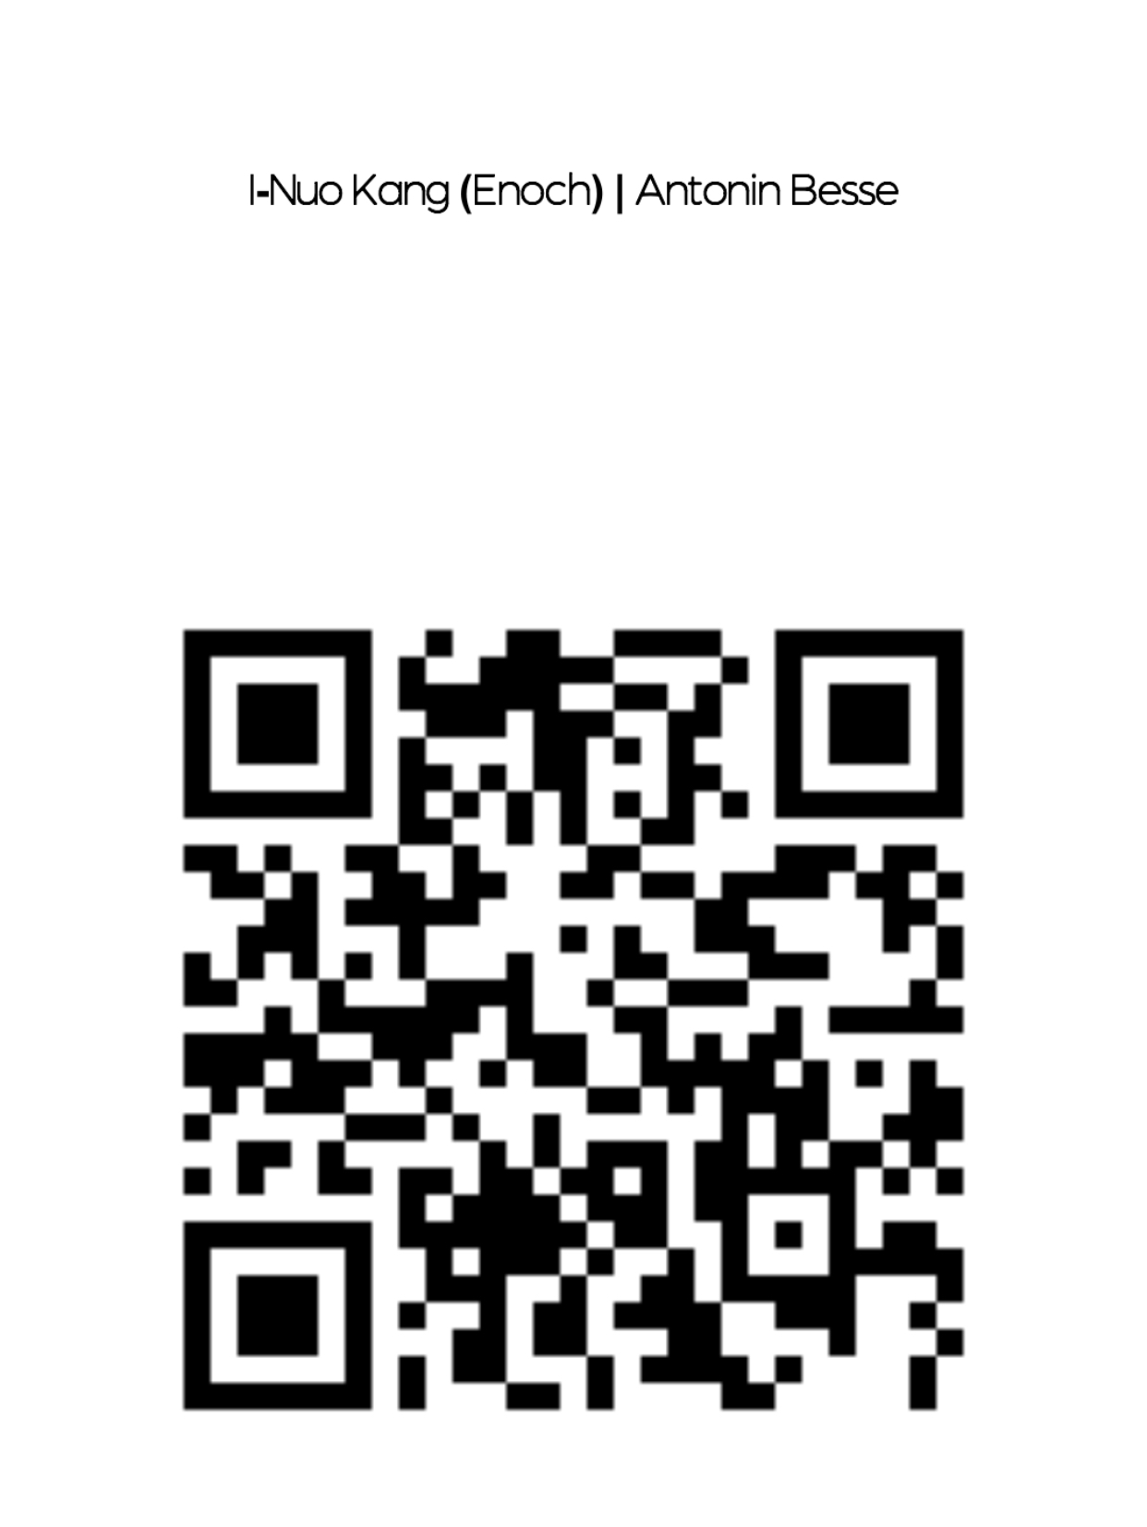
How it works
Step 1
Step 2
Player
completes a task
Task is verified by either QR code or SusCo rep
Notes:
Basic structure:
Player makes eco brick
Player takes eco brick to a SusCo rep to verify
SusCo rep checks that the brick is in good condition, collects the brick then grants the player the points

Slide 5
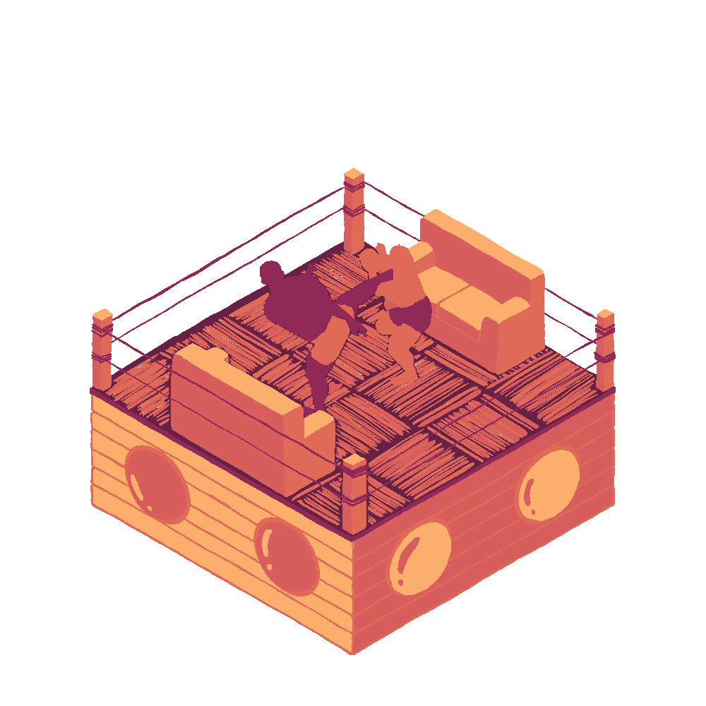
Design
Sunley
Kurt Hahn
Gwynedd
Madiba
Tice
Whitaker
Powys
Antonin Besse

Slide 6
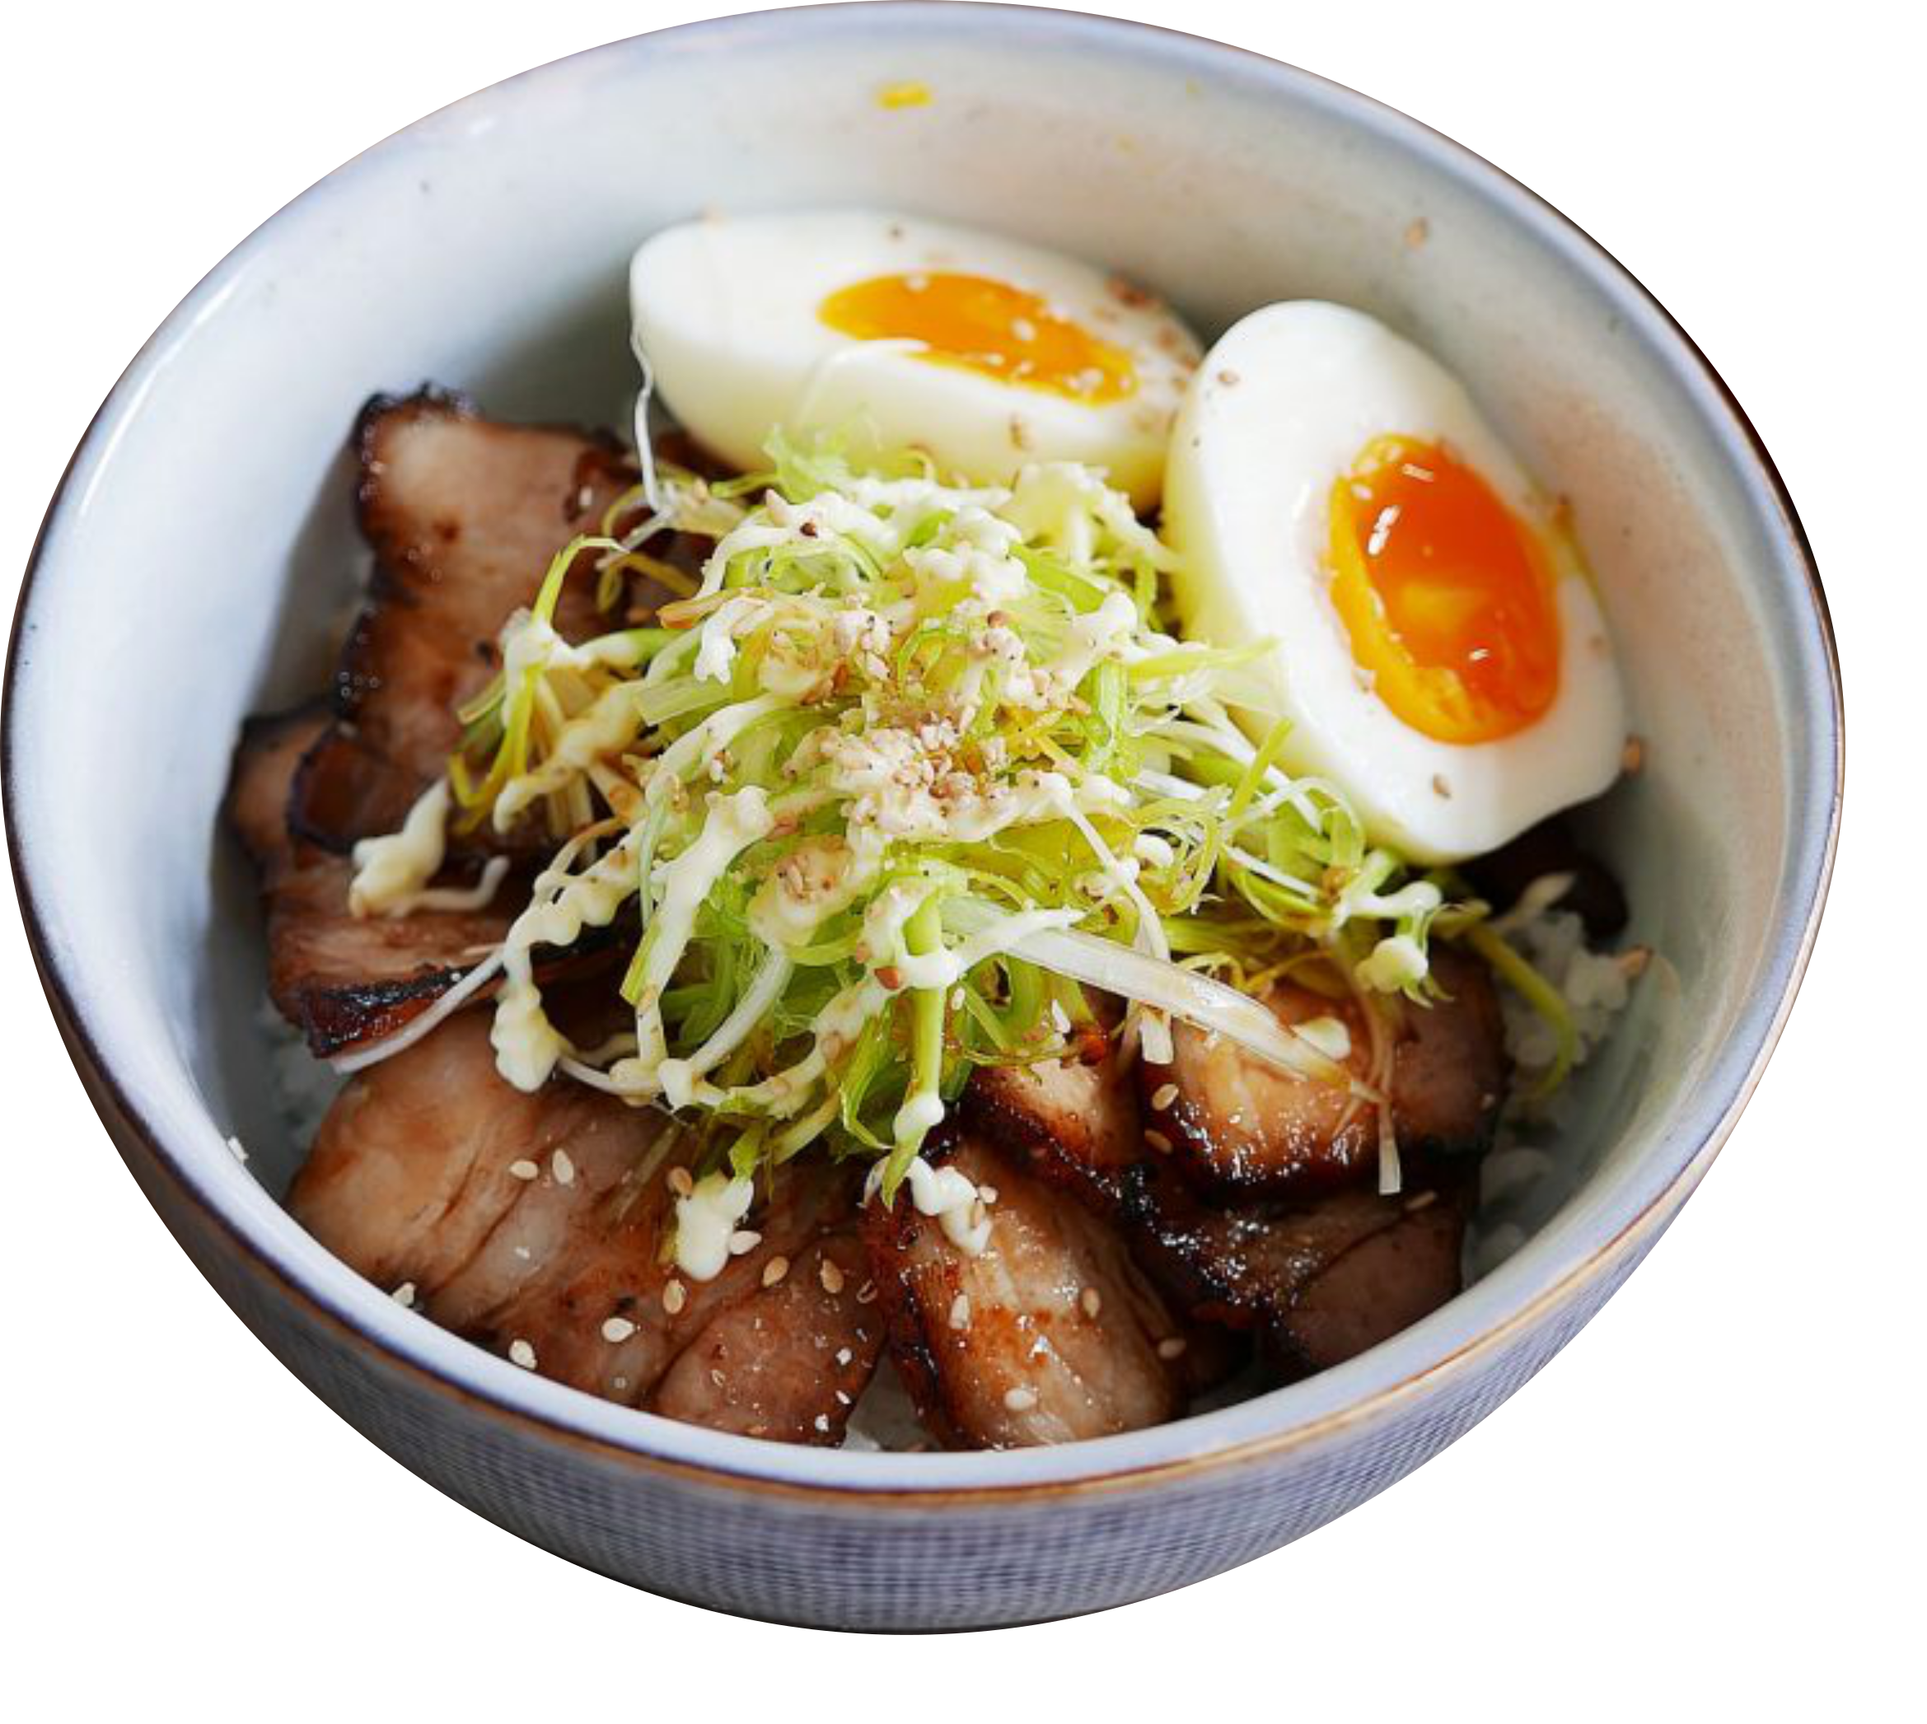
Rewards
Top ten players get a Hot To Go meal sponsored by Eco City by the end of the term!

Slide 7
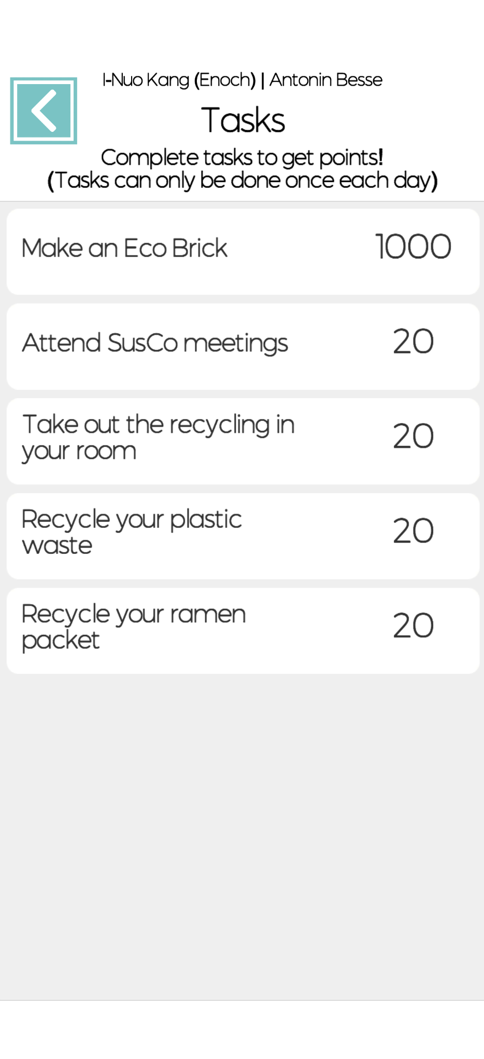
Tasks
Verification:
Automatic or in person
Task creation:
Tasks can be created and edited for special events or workshops
Notes:
Task system
Automatic: For simple tasks that the players need to do more often. Can be done once a day, verified by scanning a QR code.
SusCo reps: For larger tasks like making eco bricks. SusCo reps can check the quality of the bricks before the reward is granted. Verified by finding a SusCo rep.
Tasks can be created and edited for special events like encouraging players to attend SusCo workshops.

Slide 8
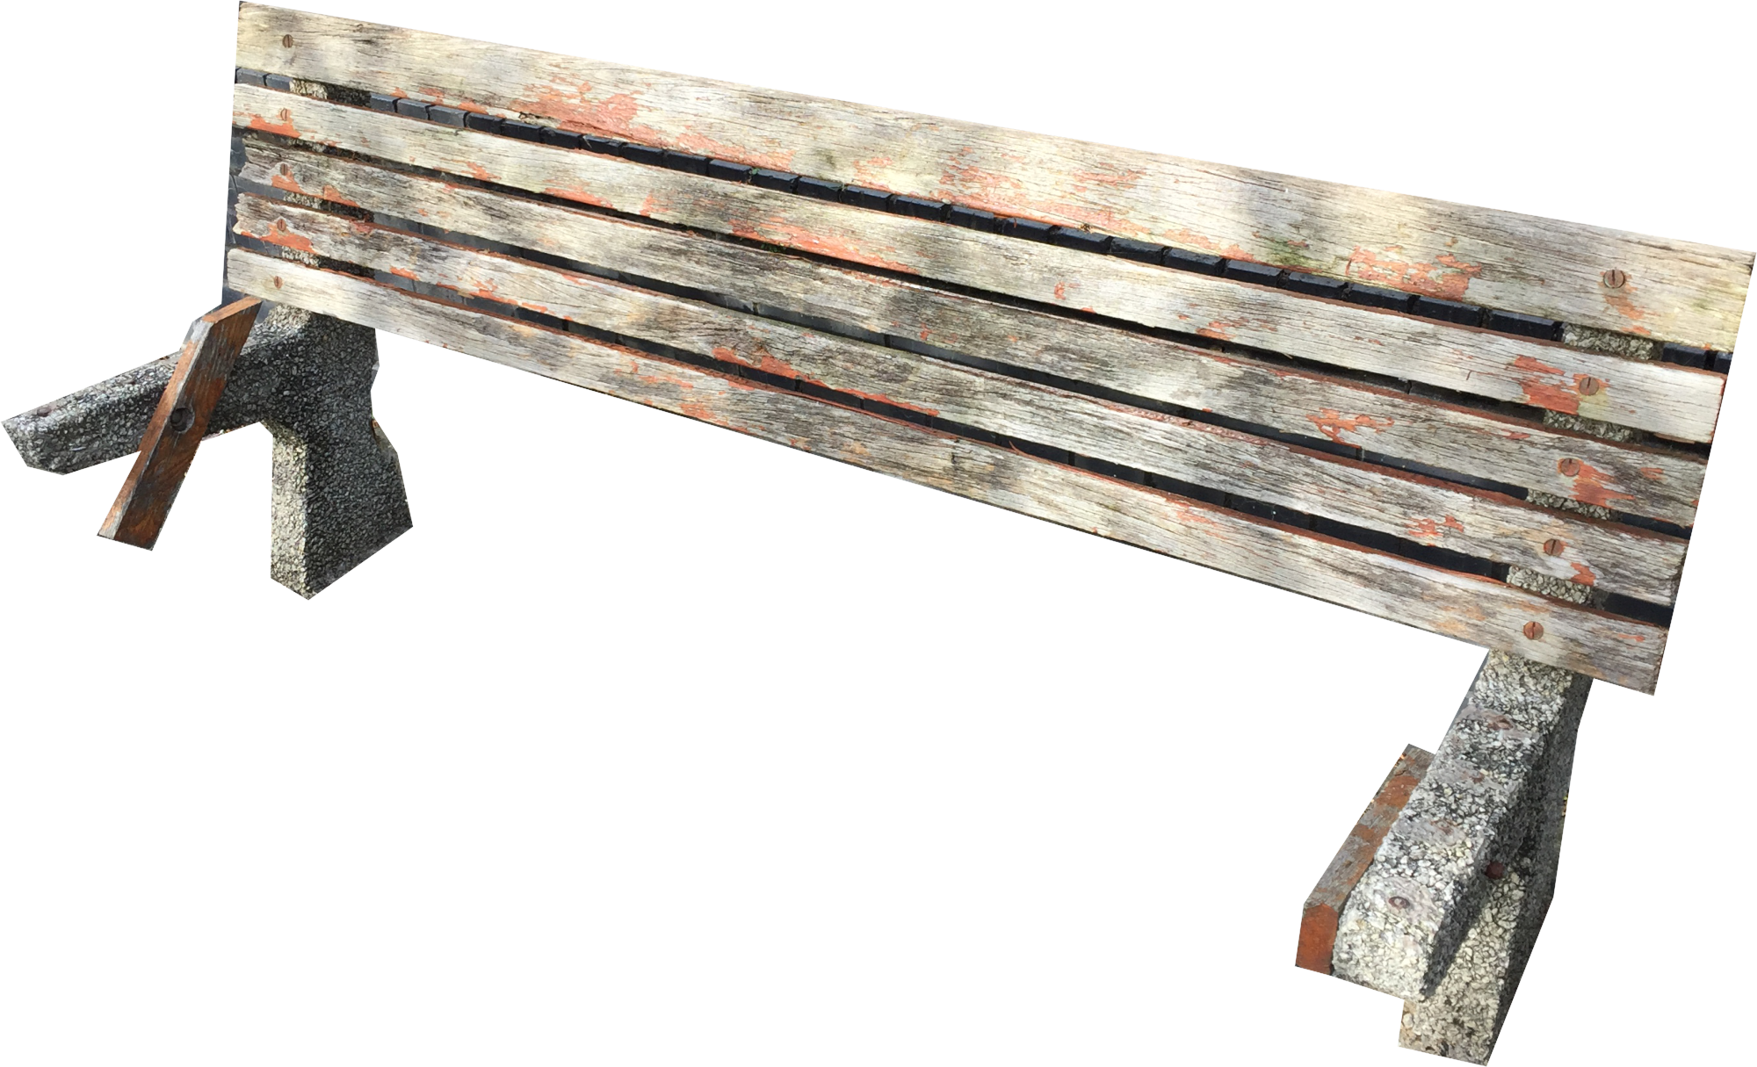
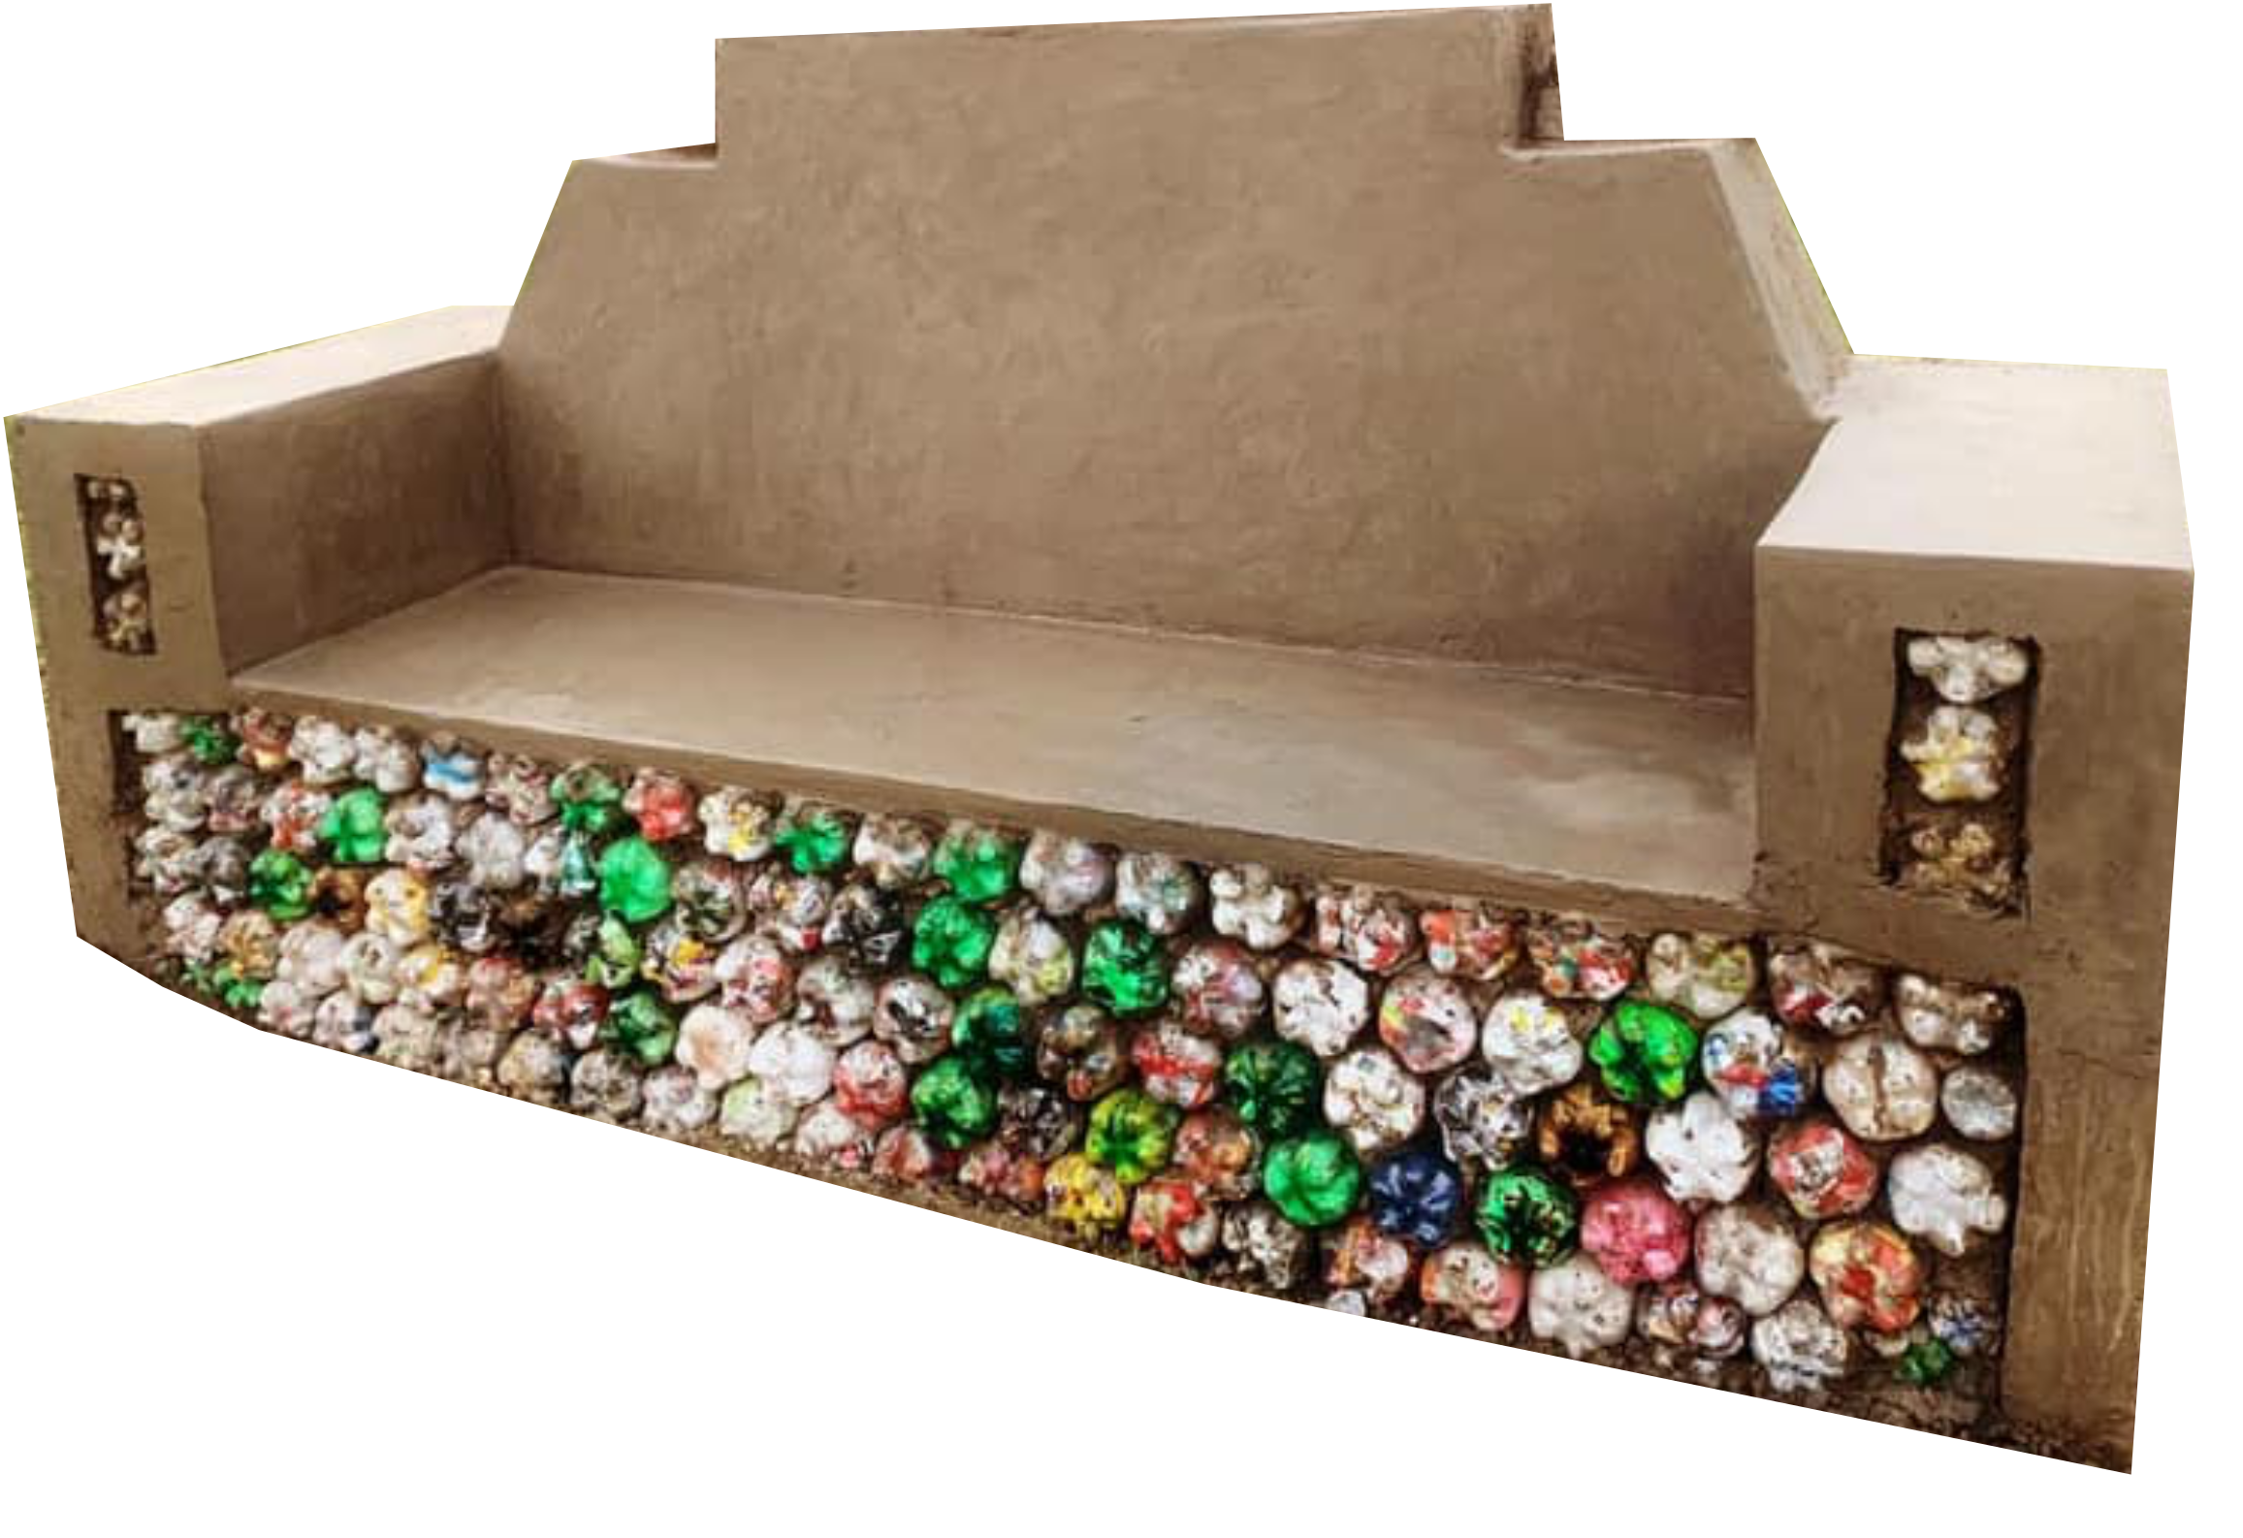
What’s next?
Notes:
Slogan: Build a better place
Building benches
Taking part of events such as

Slide 9
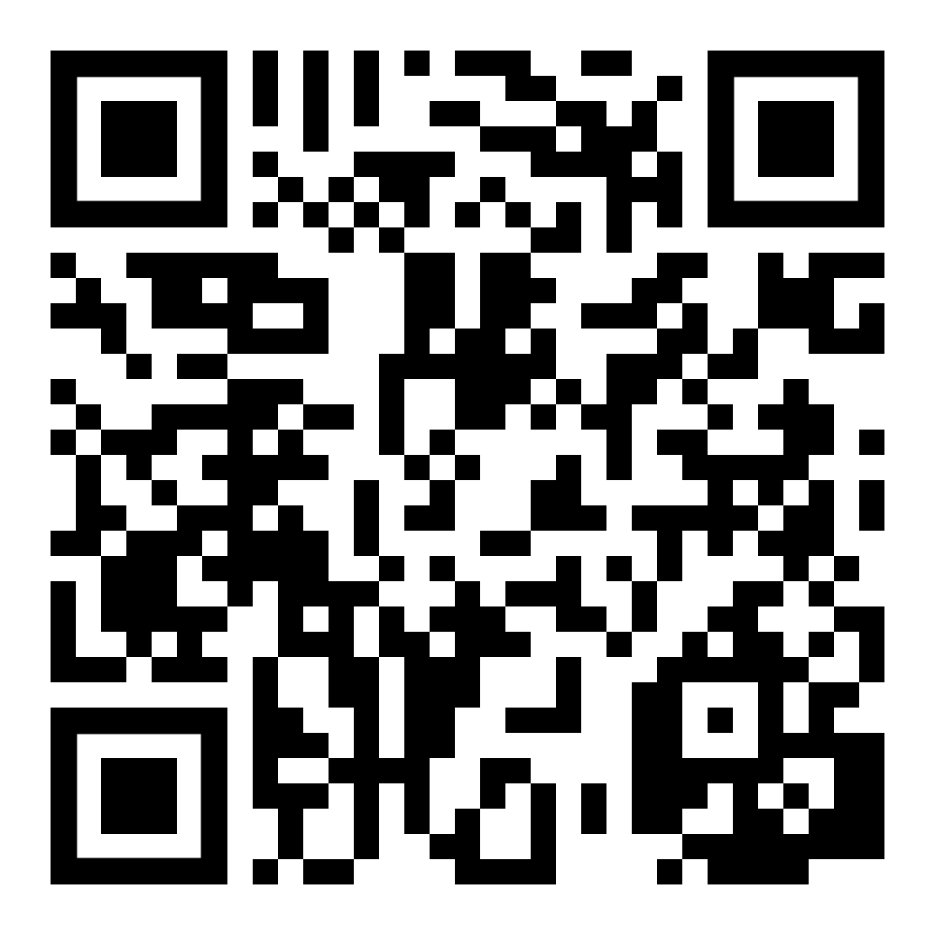
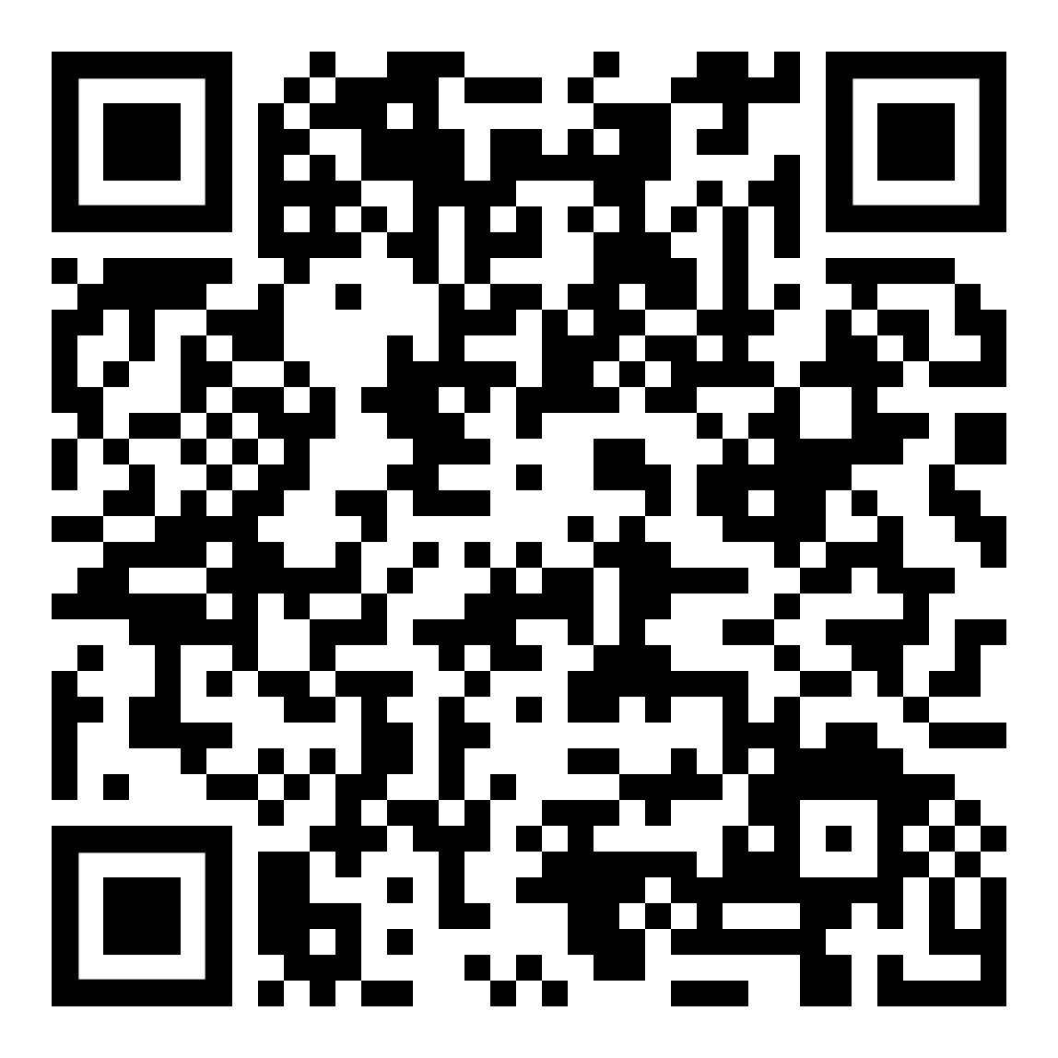
Download now! Links also available in email.

